Slide 1
Efficient Latency Guarantees for Mixed-criticality Networks-on-Chip
Sebastian Tobuschat, Rolf Ernst
IDA, TU Braunschweig, Germany
18. April 2017, Pittsburgh, PA, USA
CPSWeek • RTAS 2017

Slide 2
Current and Future Embedded Systems
multicore architectures are reaching safety-critical embedded systems
e.g. sensor fusion and recognition in highly automated driving
integrate previously distributed functions in a single chip
→ mixed-criticality systems
standards require isolation in case of shared resources
e.g. IEC 61508: “sufficient independence”

Slide 3
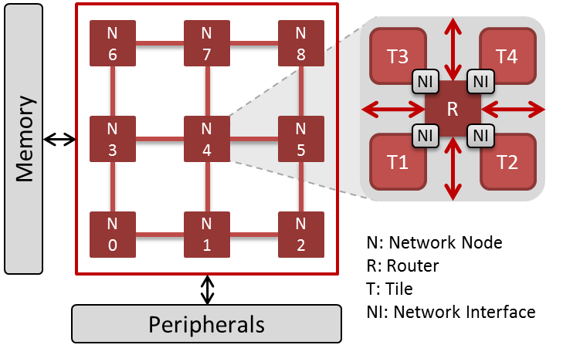
Networks-on-Chip (NoC)
offer high-performance, scalability and flexibility
transmissions share NoC resources
e.g. buffers, links
→ provide isolation
consequences
highest relevant safety level for shared parts
→ expensive
or implement “sufficient independence”
→ Quality of Service mechanisms (QoS)
main Challenge: QoS guarantees + high performance

Slide 4
Providing Quality of Service – Related Work
static partitioning (e.g. TDMA):
e.g. [Milberg2004], [Goossens2010], [Psarras2015], [Panades2006], [Hansson2007]
→ typically reduced utilization
prioritization:
e.g. [Bolotin2004], [Bjerregaard2005]
“criticality as priority”
→ reduced performance for BE
dual Priority:
e.g. [Burns2014], [Indrusiak2015]
based on behavior of safety-critical sender:
send with either high or low priority
not accounting for NoC load; only for whole path
→ reduced exploitation of latency slack

Slide 5
Providing Quality of Service – Related Work
static partitioning (e.g. TDMA):
e.g. [Milberg2004], [Goossens2010], [Psarras2015], [Panades2006], [Hansson2007]
→ typically reduced utilization
prioritization:
e.g. [Bolotin2004], [Bjerregaard2005]
“criticality as priority”
→ reduced performance for BE
dual Priority:
e.g. [Burns2014], [Indrusiak2015]
based on behavior of safety-critical sender:
send with either high or low priority
not accounting for NoC load; only for whole path
→ reduced exploitation of latency slack
Goal: minimize negative performance impact of QoS mechanisms (on non-critical senders)
Idea: prioritize BE to exploit (latency) slack of critical applications

Slide 6
Outline
Motivation
Providing Quality of Service
Latency Guarantees
Experimental Results
Conclusion
Notes:
2

Slide 7
Idea
latency slack
difference between worst-case latency and deadline
safety critical applications do not benefit from finishing before deadline
but BE applications benefit from low latency
baseline approach:
two traffic classes: guaranteed latency (GL) and best effort (BE)
prioritize BE over GL and limit interference BE induces to GL to exploit slack of GL
utility(f)
deadline
finishing time f
utility function of a firm/hard real-time task (Stankovic1998)

Slide 8
Limit BE Interference
extend (GL) packet header with blocking counter (BC)
packet or flit level (tradeoff: performance and overhead)
for small or single size packets → packet level sufficient
different sizes or more fine granular → flit level
BC is evaluated and adapted in each router
decremented when packet is blocked by higher priority packet (this can be BE or other GL with BC=0)
if BC of a packet/flit reaches zero:
prioritize queue containing it over BE, until no packet/flit with BC=0 is remaining
other implementation possible: sorting, forwarding/overtaking

Slide 9
Blocking Counter
header field allows to freely distributed the allowed blocking on the path, based on actual needs of BE
account for local or temporary traffic hot spots
initial value obtained from analysis
optimization problem: find initial BC value that minimizes slack, while all (GL) streams are schedulable
can account for local behavior of sender and (online) adapt BC on packet level
e.g. using sender information (cf. [Burns2014], [Indrusiak2015])
e.g. allow mode change, software update, task re-mapping

Slide 10
Outline
Motivation
Providing Quality of Service
Latency Guarantees
Experimental Results
Conclusion
Notes:
2

Slide 11
Worst-case Latency
based on [Rambo2015] – compositional performance analysis
local router analysis
worst-case multiple activation processing time for a stream $B_{i}^{+}$
maximum time resource (router) is busy processing q flits of a stream
used to derive worst-case latency $R_{i}^{+}$ of each hop
break down into sum of different terms addressing different blocking factors
for each stream
analyze routers along its path and propagate event models downstream
formally analyze routers iteratively

Slide 12
Worst-case Multiple Activation Processing Time
$B_{i}^{+}\left(q,a_{i}^{q}\right)≤q∗C +B_{i}^{out}\left(B_{i}^{+}\left(q,a_{i}^{q}\right)−C,q\right)$ $+ B_{i}^{in}\left(B_{i}^{+}\left(q,a_{i}^{q}\right),q,a_{i}^{q}\right) +B_{i,q}^{LP}(B_{i}^{+}\left(q,a_{i}^{q}\right)−C)$
State norm
Arbitration
Input 1
BE
2
2
Output 1
GL
…
…
Input n
Output n
BE
1
1
$q$: number of flits
$a_{i}^{q}$ : arrival time of event q
C : single flit transmission time
GL
For details and equations look into the paper

Slide 13
Worst-case Multiple Activation Processing Time
$B_{i}^{+}\left(q,a_{i}^{q}\right)≤q∗C +B_{i}^{out}\left(B_{i}^{+}\left(q,a_{i}^{q}\right)−C,q\right)$ $+ B_{i}^{in}\left(B_{i}^{+}\left(q,a_{i}^{q}\right),q,a_{i}^{q}\right) +B_{i,q}^{LP}(B_{i}^{+}\left(q,a_{i}^{q}\right)−C)$
State norm
Arbitration
flit transmission
Input 1
BE
2
2
Output 1
GL
…
…
Input n
Output n
BE
1
1
$q$: number of flits
$a_{i}^{q}$ : arrival time of event q
C : single flit transmission time
GL
For details and equations look into the paper

Slide 14
Worst-case Multiple Activation Processing Time
$B_{i}^{+}\left(q,a_{i}^{q}\right)≤q∗C +B_{i}^{out}\left(B_{i}^{+}\left(q,a_{i}^{q}\right)−C,q\right)$ $+ B_{i}^{in}\left(B_{i}^{+}\left(q,a_{i}^{q}\right),q,a_{i}^{q}\right) +B_{i,q}^{LP}(B_{i}^{+}\left(q,a_{i}^{q}\right)−C)$
State norm
Arbitration
interference at output
Input 1
BE
2
2
Output 1
GL
…
…
Input n
Output n
BE
1
1
$q$: number of flits
$a_{i}^{q}$ : arrival time of event q
C : single flit transmission time
GL
For details and equations look into the paper

Slide 15
Worst-case Multiple Activation Processing Time
$B_{i}^{+}\left(q,a_{i}^{q}\right)≤q∗C +B_{i}^{out}\left(B_{i}^{+}\left(q,a_{i}^{q}\right)−C,q\right)$ $+ B_{i}^{in}\left(B_{i}^{+}\left(q,a_{i}^{q}\right),q,a_{i}^{q}\right) +B_{i,q}^{LP}(B_{i}^{+}\left(q,a_{i}^{q}\right)−C)$
State norm
Arbitration
interference at input
Input 1
BE
1
1
2
2
Output 1
GL
…
…
Input n
Output n
BE
1
1
$q$: number of flits
$a_{i}^{q}$ : arrival time of event q
C : single flit transmission time
GL
For details and equations look into the paper

Slide 16
Worst-case Multiple Activation Processing Time
$B_{i}^{+}\left(q,a_{i}^{q}\right)≤q∗C +B_{i}^{out}\left(B_{i}^{+}\left(q,a_{i}^{q}\right)−C,q\right)$ $+ B_{i}^{in}\left(B_{i}^{+}\left(q,a_{i}^{q}\right),q,a_{i}^{q}\right) +B_{i,q}^{LP}(B_{i}^{+}\left(q,a_{i}^{q}\right)−C)$
State norm
t=0
new interference through BC
Arbitration
Input 1
BE
1
1
2
2
Output 1
GL
…
…
Input n
Output n
BE
1
1
$q$: number of flits
$a_{i}^{q}$ : arrival time of event q
C : single flit transmission time
GL
For details and equations look into the paper

Slide 17
Worst-case Multiple Activation Processing Time
$B_{i}^{+}\left(q,a_{i}^{q}\right)≤q∗C +B_{i}^{out}\left(B_{i}^{+}\left(q,a_{i}^{q}\right)−C,q\right)$ $+ B_{i}^{in}\left(B_{i}^{+}\left(q,a_{i}^{q}\right),q,a_{i}^{q}\right) +B_{i,q}^{LP}(B_{i}^{+}\left(q,a_{i}^{q}\right)−C)$
State norm
t=1
new interference through BC
Arbitration
send BE
and
decrement BC
Input 1
BE
1
1
1
1
Output 1
GL
…
…
Input n
Output n
BE
1
1
$q$: number of flits
$a_{i}^{q}$ : arrival time of event q
C : single flit transmission time
GL
For details and equations look into the paper

Slide 18
Worst-case Multiple Activation Processing Time
$B_{i}^{+}\left(q,a_{i}^{q}\right)≤q∗C +B_{i}^{out}\left(B_{i}^{+}\left(q,a_{i}^{q}\right)−C,q\right)$ $+ B_{i}^{in}\left(B_{i}^{+}\left(q,a_{i}^{q}\right),q,a_{i}^{q}\right) +B_{i,q}^{LP}(B_{i}^{+}\left(q,a_{i}^{q}\right)−C)$
State norm
t=2
new interference through BC
Arbitration
send BE
and
decrement BC
Input 1
BE
1
1
0
0
Output 1
GL
…
…
Input n
Output n
BE
1
1
$q$: number of flits
$a_{i}^{q}$ : arrival time of event q
C : single flit transmission time
GL
For details and equations look into the paper

Slide 19
Worst-case Multiple Activation Processing Time
$B_{i}^{+}\left(q,a_{i}^{q}\right)≤q∗C +B_{i}^{out}\left(B_{i}^{+}\left(q,a_{i}^{q}\right)−C,q\right)$ $+ B_{i}^{in}\left(B_{i}^{+}\left(q,a_{i}^{q}\right),q,a_{i}^{q}\right) +B_{i,q}^{LP}(B_{i}^{+}\left(q,a_{i}^{q}\right)−C)$
State crit
t=3
new interference through BC
Arbitration
as BC=0
send GL
Input 1
BE
1
1
0
0
Output 1
GL
…
…
Input n
Output n
BE
1
1
$q$: number of flits
$a_{i}^{q}$ : arrival time of event q
C : single flit transmission time
GL
For details and equations look into the paper

Slide 20
Interference through BC
additional blocking allowed by the blocking counter (BC)
depends on:
higher priority traffic (BE or GL with BC=0)
blocking counter
part of event model propagation
$$B_{i,q}^{LP}\left(Δt\right)≤C∗\min\left\{\sum_{j∈hp\left(i\right)}{ƞ_{j}^{+}\left(∆t\right)},χ_{i} \right\}$$
$$χ_{i}=\left\{\begin{aligned}{BC}_{i}^{q}∗\hat{n}, if BC counts packets \\ {BC}_{i}^{q}, otherwise\end{aligned}\right.$$
$\hat{n}$: packet sitze in flits
C : single flit transmission time
$ƞ_{j}^{+}(Δt)$: maximum number of flits that arrive in $Δt$
$hp\left(i\right)$: set of streams with higher priority than i
number of interfering flits
current value of BC (in flits)
For details look into the paper

Slide 21
Outline
Motivation
Providing Quality of Service
Latency Guarantees
Experimental Results
Conclusion
Notes:
2

Slide 22
Evaluation
OMNeT++ framework + HNOCs library
one VC for GL; 4 VCs for BE
buffer size: 6 packets
router with 4 stage pipeline
packet size: 4 flits
XY-routing
BC counting flits
two sets of experiments:
synthetic workload: general properties
benchmark based: performance improvement

Slide 23
Experiment 1
synthetic workload, simple line topology
periodically injecting packets
injection jitter: 25% of period
increase load → decrease period
one GL stream overlapped by four BE streams
different values for BC (note BC=0 → classic prioritization)
R
R
R
R
R
R
R
CPU
CPU
CPU
CPU
CPU
CPU
CPU
τ₁
τ₂
τ₃
τ₄
τ₅
τ₆
τ₇
GL communication
BE communication

Slide 24
Experiment 1 – GL Latency (τ₁)
GL load: 0.1 flits/cycle/node (i.e. 10% link bandwidth)
analyzed latency increases with BC

Slide 25
Experiment 1 – BE Latency
BE load: 0.2 flits/cycle/node (i.e. 20% link bandwidth)
latency of τ₂ (solid) and τ₅ (dashed)
performance gain is higher for BE senders close to GL and for higher BC values

Slide 26
Experiment 1 – GL Backlog (τ₁)
BE load: 0.2 flits/cycle/node (i.e. 20% link bandwidth)
possible backlog increases with BC and load

Slide 27
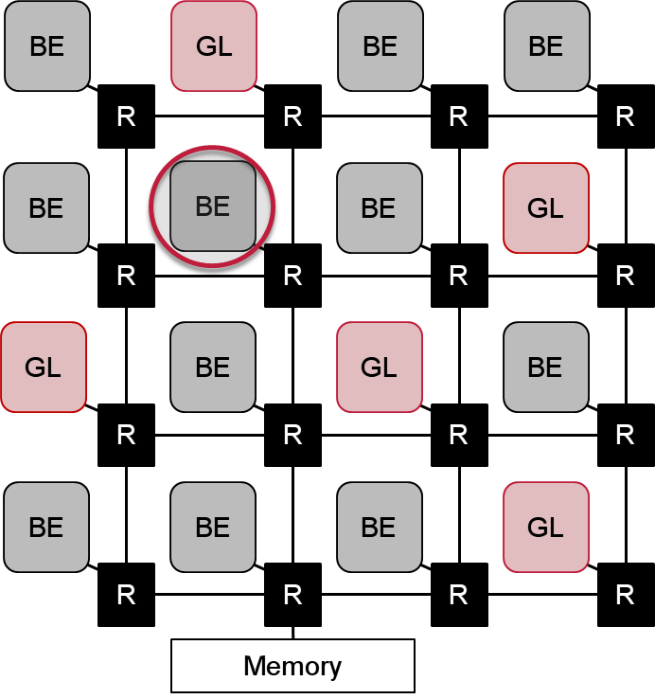
Experiment 2
benchmark based
traces from CHStone
extracted using Gem5: ARMv7, 32kB L1
accesses to network (e.g. memory access, communication, cache access)
random destinations
random mappings of interfering load
latency for highlighted BE node

Slide 28
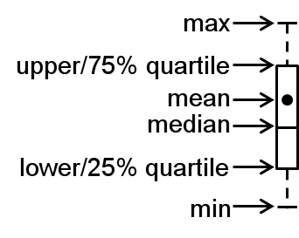
Experiment 2 – Random Destinations - BE Latency
latency normalized to average latency of HP
distribution over all mappings
increased jitter (for BE)
45% lower average latency

Slide 29
Synthesis Results
2x2 NoC, 5 VCs, buffer size of 6 packets per VC
Virtex-6 LX760 FPGA, Xilinx ISE 14.6, standard settings
4 approaches
baseline: round robin
FP: one prioritized VC for GL (RR for requests of the same priority)
DP: flag to change priority of GL (i.e. higher or lower than BE)
BC: proposed approach (priority change on BC value)
+4.5%
Unit | Baseline | FP | DP | BC
#Registers | 9365 | 9395 | 9389 | 9740
#LUTs | 12149 | 12205 | 12199 | 12688
Freq. (MHz) | 210 | 210 | 210 | 210
+4.0%

Slide 30
Outline
Motivation
Providing Quality of Service
Latency Guarantees
Experimental Results
Conclusion
Notes:
2

Slide 31
Conclusion
run-time configurable, dynamic prioritization of GL to exploit latency slack of safety-critical applications
based on actual blocking through BE
prioritize BE over GL when possible
increased performance for BE
up to 45% lower average latency
increased jitter
less than 5% hardware overhead (for non optimized solution)
future work:
evaluate different strategies for BC (e.g. limit end-to-end and per router)
account for backpressure
Thank you for your attention.
Questions?

Slide 32
References
[Bjerregaard2005]T. Bjerregaard and J. Sparsoe, “Scheduling discipline for latency and bandwidth guarantees in asynchronous network-on-chip,” in Asynchronous Circuits and Systems, 2005. ASYNC 2005. Proceedings. 11th IEEE International Symposium on, pp. 34–43, March 2005.
[Bolotin2004] E. Bolotin, I. Cidon, R. Ginosar, and A. Kolodny, “QNoC: QoS architecture and design process for network on chip,” J. Syst. Archit., vol. 50, pp. 105–128, Feb. 2004.
[Burns2014] A. Burns, J. Harbin, and L. Indrusiak, “A wormhole NoC protocol for mixed criticality systems,” in Real-Time Systems Symposium (RTSS), 2014 IEEE, pp. 184–195, Dec. 2014.
[Goossens2010] K. Goossens and A. Hansson, “The aethereal network on chip after ten years: Goals, evolution, lessons, and future,” in Proceedings of the 47th Design Automation Conference, DAC ’10, (New York, NY, USA), pp. 306–311, ACM, 2010.
[Hansson2007] A. Hansson, M. Coenen, and K. Goossens, “Channel trees: Reducing latency by sharing time slots in time-multiplexed networks on chip,” in CODES+ISSS, pp. 149–154, Sept 2007.
[Indrusiak2015] L. Indrusiak, J. Harbin, and A. Burns, “Average and worst-case latency improvements in mixed-criticality wormhole networks-on-chip,” in Real-Time Systems (ECRTS), 2015 27th Euromicro Conference on, pp. 47–56, July 2015.
[Milberg2004] M. Millberg, E. Nilsson, R. Thid, and A. Jantsch, “Guaranteed bandwidth using looped containers in temporally disjoint networks within the nostrum network on chip,” in Design, Automation and Test in Europe Conference and Exhibition, 2004. Proceedings, vol. 2, pp. 890–895 Vol.2, Feb 2004.
[Panades2006] I. Miro Panades, A. Greiner, and A. Sheibanyrad, “A low cost network-on-chip with guaranteed service well suited to the gals approach,” in Nano-Networks and Workshops, 2006. NanoNet ’06. 1st International Conference on, pp. 1–5, Sept 2006.
[Psarras2015] A. Psarras, I. Seitanidis, C. Nicopoulos, and G. Dimitrakopoulos, “Phasenoc: Tdm scheduling at the virtual-channel level for efficient network traffic isolation,” in Proceedings of the 2015 Design, Automation & Test in Europe Conference & Exhibition, DATE ’15, (San Jose, CA, USA), pp. 1090–1095, EDA Consortium, 2015.
[Rambo2015] E. A. Rambo and R. Ernst, “Worst-case communication time analysis of networks-on-chip with shared virtual channels,” in Proceedings of the 2015 Design, Automation & Test in Europe Conference & Exhibition, DATE ’15, (San Jose, CA, USA), pp. 537–542, EDA Consortium, 2015.

Slide 33
Back Up
Backup Slides

Slide 34
Experiment 2 – Hot Module - BE Latency
all nodes sending to memory
distribution over all mappings

Slide 35
Operational Example (step 0)
Router in normal state (i.e. BE has high priority)
Two GL packets (with BC=1) waiting
State norm
t=0
Arbitration
Input
BE
Output 1
1
1
GL

Slide 36
Operational Example (step 1)
GL packet is sent
BE packet arrives
State norm
t=1
Arbitration
Input
BE
1
Output 1
2
1
GL

Slide 37
Operational Example (step 2)
Send BE packet, as GL still allows blocking
BC of GL is decremented
New BE packet arrives
State norm
t=2
Arbitration
Input
BE
Output 1
2
0
GL

Slide 38
Operational Example (step 3)
GL achieves higher priority (as BC==0)
Send GL packet, BE is blocked
New BE packet arrives
State crit
t=3
Arbitration
Input
BE
0
Output 1
2
GL

Slide 39
Operational Example (step 4)
Send BE packet (as no GL was waiting)
New GL packet arrives
State norm
t=4
Arbitration
Input
BE
Output 1
2
2
GL

Slide 40
Operational Example (step 5)
Send BE packet, as GL still allows blocking
BC of GL is decremented
→ BE achieves lower latency
State norm
t=5
Arbitration
Input
BE
Output 1
2
1
GL

Slide 41
Operational Example (step 6)
Send GL packet (with BC>0) as no BE is waiting
State norm
t=6
Arbitration
Input
BE
1
Output 1
2
1
GL

Slide 42
Compositional Performance Analysis for NoCs
based on analysis from [Rambo2015]
analysis performed iteratively
step 1: local analysis (at each router)
compute worst-case latency $R_{i}^{+}$of flits based on critical instant (busy window)
derive output event models
step 2: global analysis
propagate event models downstream
go to step 1 if any event model has changed
otherwise, terminate
Environment Model
Input Event Models
Local
Scheduling Analysis
Output Event Models
Convergence or
Non-Schedulability ?
No
Terminate

Slide 43
CPA Approach
worst-case end-to-end latency relies on response times $R_{}^{+}$ from local analyses
for each stream
analyze routers along its path and propagate event models downstream
formally analyze routers iteratively
Sink 1
$$R_{}^{+}$$
$$R_{}^{+}$$
$$η_{in, S1}^{}$$
$$η_{out, S1}^{}$$
Source
Router 1
Router 2
Sink 2
$$η_{in, S2}^{}$$
$$η_{out, S2}^{}$$

Slide 44
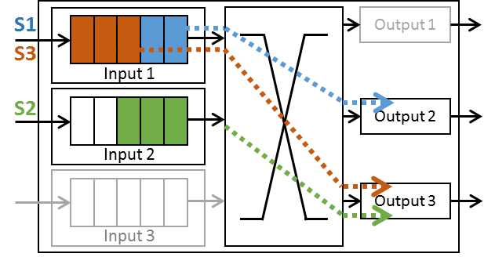
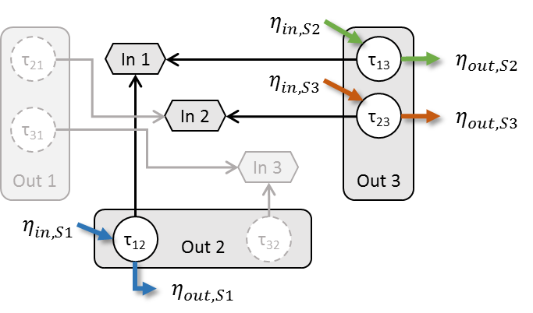
Mapping NoC Domain to Processor Resource Model
output ports → processing resources
input ports → shared resources with mutually exclusive access
traffic stream → chain of tasks mapped to resources
flit transmission → task execution
flit arrival → task activation
input and output event models

Slide 45
Network Latency
derive single hop latency $R_{}^{+}$ based on
multiple activation busy time
router’s overhead (e.g. time to determine and acquire output port)
network latency $l_{}^{+}$:
sum of single hop latencies on path
+ injection time (including backpressure at source)
+ de-/packetization overhead
$$l_{i}^{+}\left(q\right)=InjectionTime\left(q\right) \\ +PacketizationOverhead \\ +\sum_{j ∈Tasks(i)}{R_{j}^{+}}$$

Slide 46
Complex Activation Patterns
variety of activation patterns used in practice e.g. periodic + spontaneous, dual cyclic, on change
timing verification can consider them through use of minimum distance functions
i.e. specification of the minimum distance between any n consecutive events
derived from specification or rate-limiter
δ(n)
20ms
10ms
5ms
2
3
4
5
6
n
any 5 events are separated by at least 20 ms
2 events may come at once

Slide 47
Accounting for BC in Analysis
extend event model propagation for BC
minimum and maximum value for each router on path
or: test all possible combinations where BC can be consumed on path
$\#combinations= \left({\#hops+BC−1 \atop BC}\right)$
set of possible combinations can be reduced with knowledge on event model propagation
for each possible combination
check for deadline violation

